Slide 1
LUCA
The Last Universal Common Ancestor

Slide 2
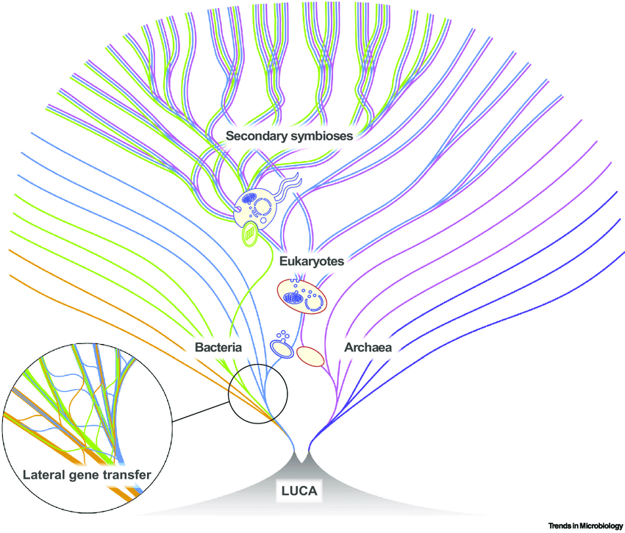
Phylogeny
Lateral gene transfer
Two vs. three domain tree of life
Problems with Weiss’s statistical phylogeny
Notes:
It’s easy to think that in our age of genome sequencing and seemingly advanced techniques for genetic analyzation, LUCA’s genome would be easier to uncover
However, as we read, due to lateral (or horizontal) gene transfer, mapping out LUCA’s genome is actually rather difficult
So lateral gene transfer is the transfer of genetic information from one organism to another in a way that’s not from producing offspring, which is how we typically think of genetic information being passed around
Lateral gene transfer can occur in a few ways, but perhaps most notably is via endosymbiosis, which is where one kind of cell sort of…swallows another, thus putting two genomes into one organism
This is one of the core issues in the two vs. three domain tree of life debate
And this is also why the Weiss et al paper was so controversial: while they were able to identify quite a few proteins that may have been present in LUCA’s genome, they allowed little room for LGT, which may have caused them to overlook some interdomain homologs (the false negatives mentioned in Gogarten and Deamer letter to the editor) and draw false conclusions about LUCA’s anatomy and physiology
One specific example of which I’ll share in the next slide
Some of you asked whether Weiss’s method of “spelling out caveats and allowing for some LGT” adequately addressed the shortcomings in their research, and if others had a problem with this approach. Additionally, some of you asked how we can compiles phylogeny with other data to figure out what LUCA was able to do
I think this goes back to what Nick Lane was talking about last week when he mentioned that researchers in the origin-of-life field tend to approach the topic with mindsets specific to their background and specialty
It seems like a transdisciplinary pedagogy would fit analysis of LUCA best
And this was acknowledged in a paper published in 2020 in response to Weiss et al. They disagreed with Weiss’s approach to analyzing LUCA, and instead suggested that statistically-produced phylogenetic trees should be compared to protein structures, species trees, and geochemical data to best determine what LUCA’s characteristics were

Slide 3
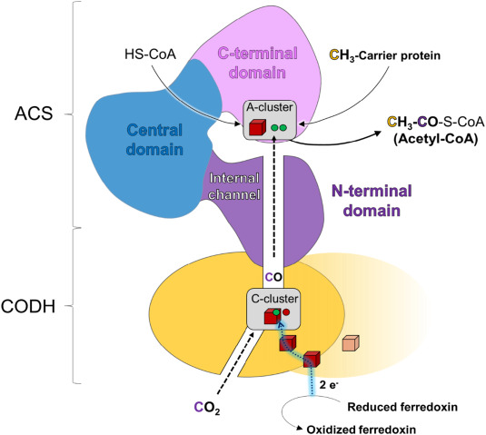
Autotrophy
Carbon monoxide dehydrogenase/Acetyl-CoA enzyme complex (CODH/ACS)
Presence in LUCA’s genome may not conclusively rule out heterotrophy
Notes:
Today, it’s mostly agreed that LUCA was an autotroph
Among the scientists that we read for today, Weiss and Martin were proponents of this theory
However, in addition to the letter to the editor we read, another article by Adam et al was published in response to Weiss et al’s
Among the 355 protein families that Weiss et al identified in their study was one for carbon monoxide dehydrogenase/acetyl-CoA synthase (CODH/ACS), which is an enzyme complex used in the Wood-Ljungdahl pathway
Back to that problem with Weiss’s research potentially having false negatives…
Adam et al identified homologs of this complex in bacteria and archaea, suggesting that the complex may have existed before the split between those two domains (and therefore may have been present in LUCA as well)
Among the archaea they found this protein in were the Thor and Loki-named ones mentioned in the “Asgard archaea” paper
Interestingly, Adam et al also suggested though that just because the complex was present in LUCA doesn’t mean that it was a functional way of fixing carbon, and may have only been a way to break down larger molecules, which is consistent with heterotrophs
Overall, though, no one else really seems to think that LUCA was a heterotroph, as the general consensus is that heterotrophs evolved from autotrophs and thus LUCA must have been an autotroph

Slide 4
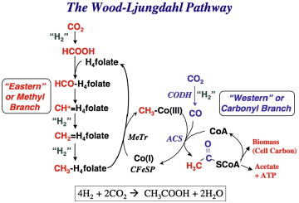
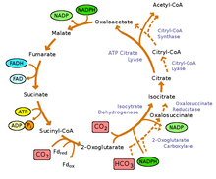
Carbon fixation: WL vs. rTCA
Notes:
Wood-Ljungdahl Pathway and the rTCA cycle
Wood-Ljungdahl was identified in Weiss et al and Martin et al as the pathway responsible for LUCA’s carbon fixation
Used by bacteria
This pathway reduces CO2 to carbon monoxide and eventually creates acetyl-CoA, which is a significant intermediate in metabolism as we understand it today
And most notably a reactant in the Krebs cycle
rTCA cycle is also known as the reverse tricarboxylic acid cycle, which is basically reverse Krebs
Also used by bacteria
This pathway uses CO2 and water as reactants and to produce carbon compounds
Could have existed in prebiotic conditions, where some steps could have been catalyzed by elements present in LUCA’s environment (like iron)
Also needs to occur under extreme heat, which may make sense for a hydrothermal vent setting
Some say that this cycle probably couldn’t have occurred without enzymes because some steps are too thermodynamically unfavorable
However a paper published in 2021 suggested that kinetically, the rTCA cycle in early life is a valid hypothesis
The WL pathway that Weiss proposed was also challenged in that same paper that suggested using additional methods of analysis, so there is still some debate going on as to which way LUCA fixed carbon

Slide 5
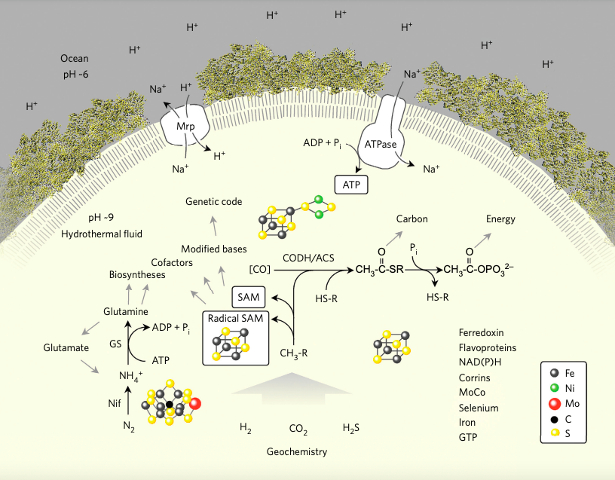
“Half-alive”
Reliance on geochemical processes
Naturally occurring H+ concentration gradients
Transition metal catalysts
Presence of genes
Notes:
Weiss claimed that LUCA was half alive
If we follow the line of thinking that has LUCA fixing carbon via the WL pathway, then LUCA is using
A Na+/H+ geochemical pH gradient, which could have been present in a alkaline hydrothermal setting
Which would help power unfavorable metabolic processes
A more stable Na+ gradient to feed a primordial Na-dependent ATP synthase
And transition metal catalysts (again, like iron) at the nitrogenase active site and the CODH/ACS active site
This leads us to the question…does metabolism need to be mostly (or entirely) self-contained in order for something to be “alive?”
Goes back to some of our first class discussions when we talked through different definitions of life
Also the question of genes
Gogarten and Deamer’s paper points out that even Weiss’s analysis suggests that “LUCA was a prokaryotic cell using nucleic acids as genetic material, genetically encoded amino acids, ribosomes for template directed protein synthesis, and membranes that allowed for chemiosmotic coupling”
Which all seem like they would constitute a full-alive organism
So, again, there remains debate here

Slide 6
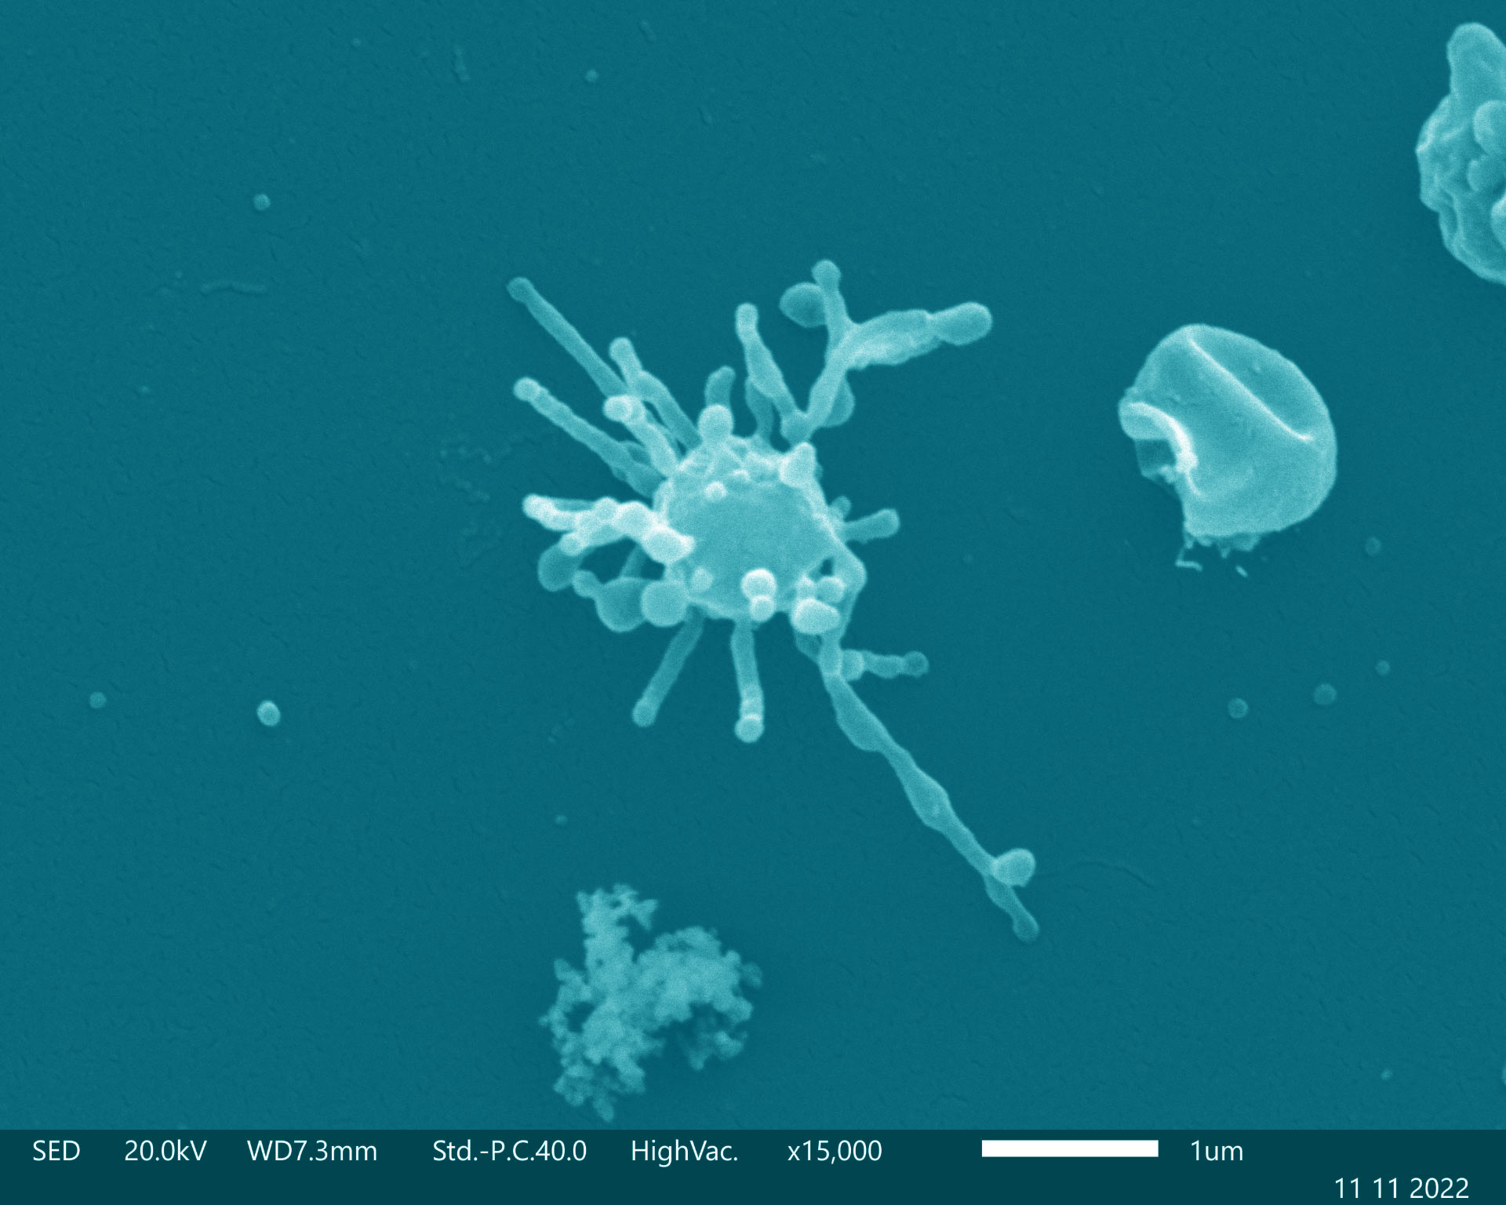
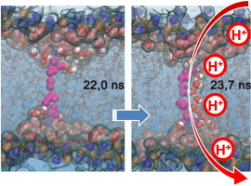
Anatomy
Asgard archaea
Vesicles and cytoskeletons
Complex structures evolve after mitochondrial integration
LUCA
Leaky bilayer membrane
Notes:
There isn’t a lot of data out there on what a LUCA would have looked like
Again, this is because of the difficulties in mapping an accurate genome for LUCA
However, some research is out there
Asgard archaea may give some clues as to what LUCA looked like
These archaea may have had vesicles and cytoskeletons
But more complex characteristics (like larger cell size / volume, nucleus, endocytic and phagocytic machineries) would have evolved after the mitochondria was acquired, which LUCA didn’t have
Sojo et al (paper in the supplemental readings) found that LUCA did not have a phospholipid membrane as they are understood today
But LUCA may have contained mixed amphiphiles, constituting a leaky lipid bilayer membrane
This would have allowed for high proton permeability, creating a natural concentration difference inside and outside of the cell and aiding in energy production via ATP synthase
While also preventing the possibility of electrochemical equilibrium (also known as death)
We’re going to discuss LUCA’s habitat and environment a bit later (when we have our debate)

Slide 7
Individual research
What are the best methods for accounting for LGT when reconstructing phylogenies? Can these be feasibly applied when studying organisms as ancient as LUCA?
How does LUCA’s hypothesized metabolism compare to the metabolisms of early archaea, bacteria, and/or eukaryotes? What does this tell us about LUCA’s complexity?
Based on the definitions of life we’ve discussed in class, would LUCA be considered alive if discovered in nature today? What about if LUCA was bioengineered/reconstructed in a lab setting?
Notes:
Pick a question that interests you (but let’s make sure all of the questions are covered)
In about 30-40 minutes, we’ll have an opportunity to share what you learned

Slide 8
Individual research
What are the best methods for accounting for LGT when reconstructing phylogenies? Can these be feasibly applied when studying organisms as ancient as LUCA?
How does LUCA’s hypothesized metabolism compare to the metabolisms of of early archaea, bacteria, and/or eukaryotes? What does this tell us about LUCA’s complexity?
Based on the definitions of life we’ve discussed in class, would LUCA be considered alive if discovered in nature today? What about if LUCA was bioengineered/reconstructed in a lab setting?
Notes:
Pick a question that interests you (but let’s make sure all of the questions are covered)
In about 30-40 minutes, we’ll have an opportunity to share what you learned

Slide 9
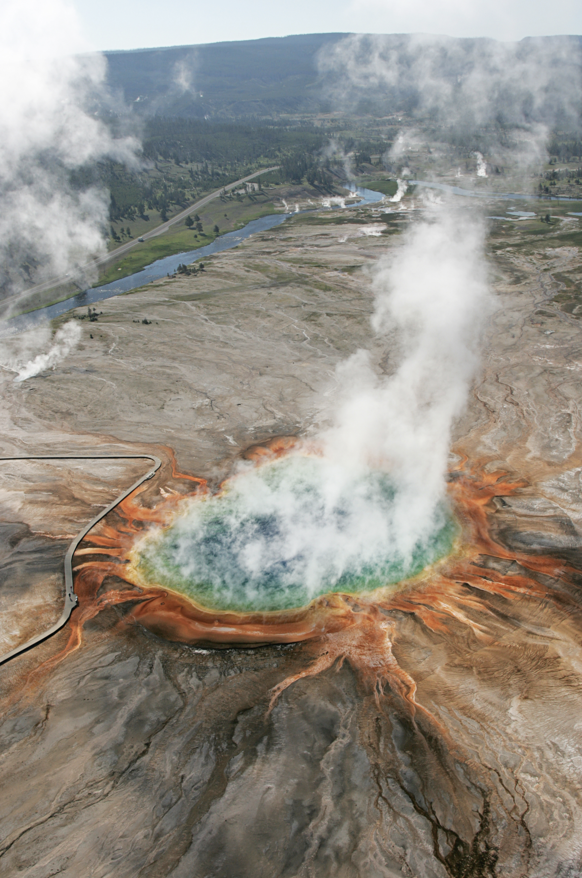
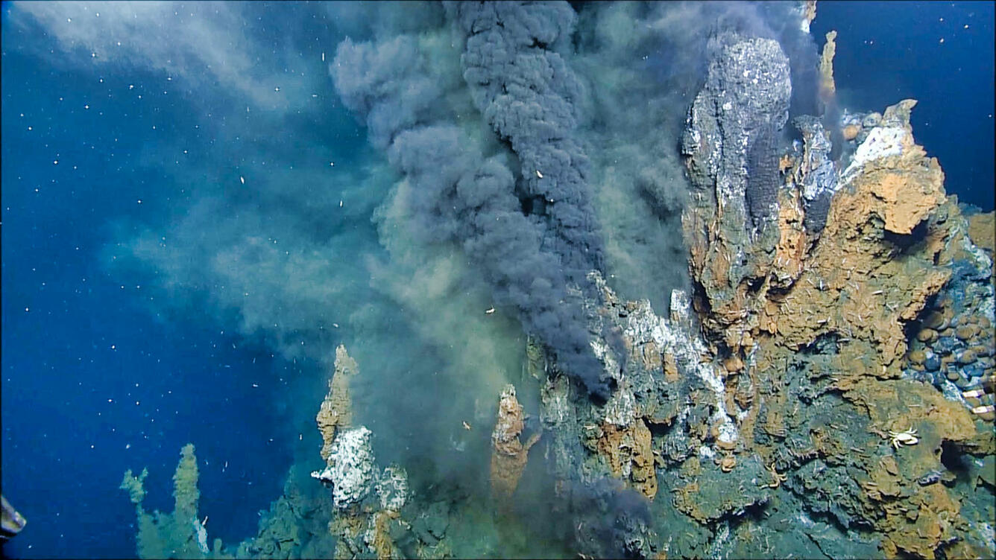
Habitat: hydrothermal vent, terrestrial hot spring, or somewhere else?
Reverse gyrase
H+ concentration gradient
Some ions not found in marine vents
Notes:
We’ve talked a lot in class so far about the role that hydrothermal vents may have played in the origin-of-life, but is this where LUCA would have lived?
Weiss reported that LUCA’s genome encoded for reverse gyrase, an enzyme specific to organisms who inhabit extremely hot environments
Cofactors needed for LUCA’s metabolism (again, transition metals) suggest hydrothermal environment
The proton concentration gradient needed for free energy in metabolism could have been supplied here as well
However, not everyone agrees that the ions needed for LUCA’s metabolism would have been present in a hydrothermal setting
Such as potassium, manganese, magnesium, zinc, and phosphate ions
Sodium may not have needed K+, Mg2+, Zn2+, Mn2+, and phosphate, but not Na+
Some researchers do not agree with the conclusion drawn by Weiss and others that reverse gyrase was present in LUCA’s genome, thus suggesting the organism may NOT have been thermophilic
Instead, they think reverse gyrase may have evolved later

Slide 10

LUCA: hot or not?
Team A
LUCA was a thermophile
Team B
LUCA was not a thermophile
4-5 people per team
Format
Initial research (30 min)
Team A’s main points (4 min)
Team B’s main points (4 min)
Rebuttal research (10 min)
Team A’s rebuttal (2 min)
Team B’s rebuttal (2 min)
Closing argument research (10 min)
Team A’s closing argument (2 min)
Team B’s closing argument (2 min)
Notes:
Were going to have a debate!

